Slide 1
Insurance Customer Response Prediction
Name: Khandu Tukaram Surwase
Course: AI and Data Science
Project Name: Insurance Customer Response Prediction

Slide 2
Insurance Customer Response Prediction
Presented By Khandu Surwase

Slide 3
01. INTRODUCTION
0.2 DATA GATHERING / DATA REFINEMENT
03. EXPLORATORY DATA ANALYSIS
04. PREPROCESSING
05. MODEL SELECTION
06. EXPERIMENTAL RESULTS
07. CONCLUSION

Slide 4

INTRODUCTION
Insurance Response prediction is a group of features affecting the customer responses to purchasing insurance policies
This dataset forms a comprehensive exploration of insurance policy features within the dataset, specifically focusing on factors related to insurance
The dataset encompass 11 features as age, gender, driving license, vintage, Vehicle Age
The target variable, ‘Response’ signifies the likelihood of insurance response

Slide 5


OBJECTIVE OF THE STUDY
Risk Management
Comparing Algorithms
Real Time Feedbacks
Value OF THE STUDY
Early prediction of customer Response
Improvement in policy
Reduce vehicle and human risk

Slide 6
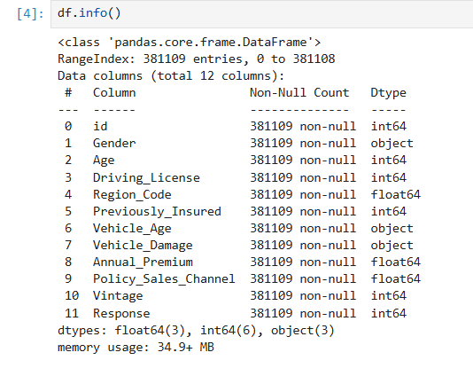
DATA GATHERING

Slide 7

EXPLORATORY DATA ANALYSIS
For continuous data: We employ histograms to gain insight into the distribution of each feature. This allows us to understand the central tendency, spread, and shape of the dataset's distribution.
For categorical data: Bar plots are utilized to visualize the frequency of each category. This provides a clear representation of the prominence of each category within the respective feature.
For continuous data: I am going to use bar plots to showcase the average value of each feature for the different target classes, and KDE plots to understand the distribution of each feature across the target classes. This aids in discerning how each feature varies between the two target outcomes.
For categorical data: I am going to employ 100% stacked bar plots to depict the proportion of each category across the target classes. This offers a comprehensive view of how different categories within a feature relate to the target.

Slide 8
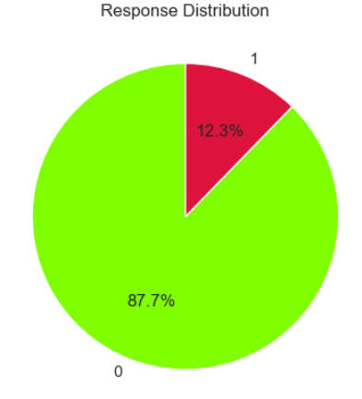
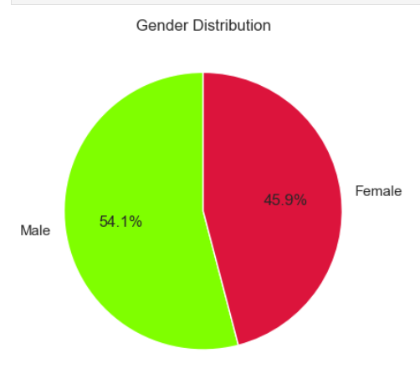
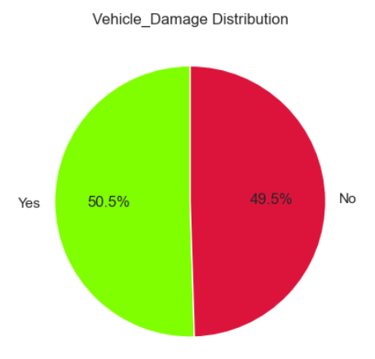
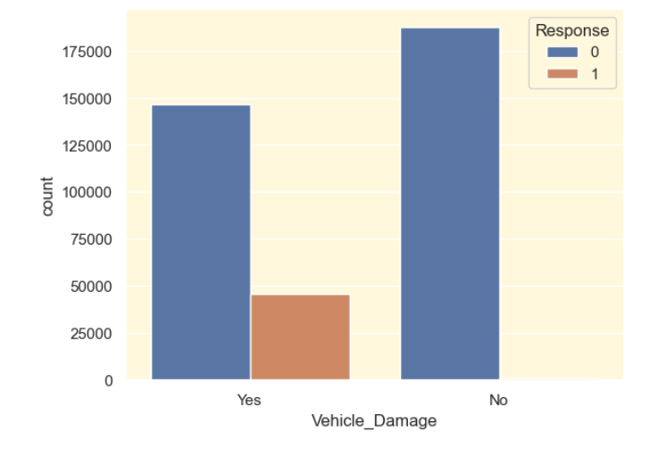

Slide 9

DATA PREPROCESSING
I am going to check for outliers using the IQR method for the continuous features:
Driving License 812 outliers, age – no outliers, vintage – no outliers
One-hot Encoding Decision:¶
Based on the feature descriptions, let's decide on one-hot encoding:
Nominal Variables: These are variables with no inherent order. They should be one-hot encoded because using them as numbers might introduce an unintended order to the model.
Ordinal Variables: These variables have an inherent order. They don't necessarily need to be one-hot encoded since their order can provide meaningful information to the model.
Upon our above inspection, it is obvious that there are no missing values in our dataset. This is ideal as it means we don't have to make decisions about imputation or removal, which can introduce bias or reduce our already limited dataset size.

Slide 10
MODEL SELECTION
Logistic Regression
Decision Tree
Random Forest
Provides Probability outputs for each class
Used as a baseline model for comparison.
Handles non-linear relationships and interactions between features.
Works with both categorical and numerical data.
No need for feature scaling or transformation.
Useful when model interpretability is important
An ensemble model made of multiple Decision Trees.
Offers higher accuracy and better generalization than a single tree.
Provides feature importance scores for model interpretation.

Slide 11
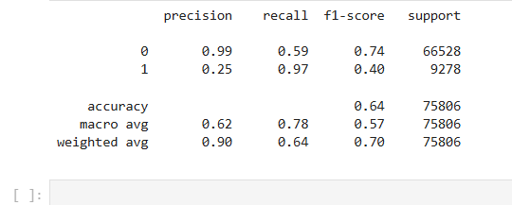
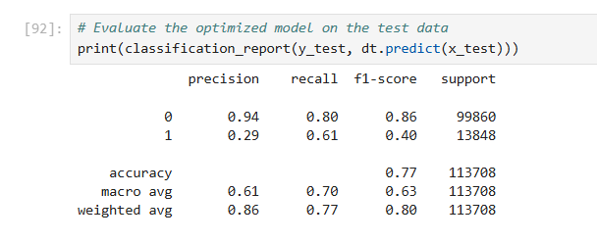
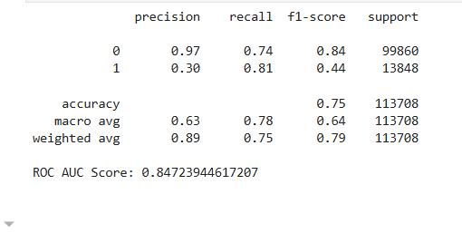
Experimental Results
Logistic Regression
Decision Tree
Random Forest

Slide 12
In this project, we successfully built and evaluated classification models to predict whether a customer will respond to an insurance offer.
Among the models used — Logistic Regression, Decision Tree, and Random Forest — Random Forest delivered the best performance in terms of accuracy and recall, especially for the minority (positive) class.
Data preprocessing techniques such as feature encoding, handling class imbalance, and scaling (for LR) were crucial for model performance.
Conclusion

Slide 13
Thank You!

